Slide 1
NETFLIX Analysis & Results Based On Ages
Group 17
Anitha Nari
11550658

Slide 2
Introduction
Domain:
I have taken the dataset from Kaggle source of the Netflix to compare the types of Shows seen by the different age groups.
Dataset has tv shows names, director name, age groups, hours spent by the users, years.

Slide 3
Dataset
A large selection of movies, TV episodes, and original content are available on the well-known streaming service Netflix. The original dataset is available here; this dataset is a cleaned version of it. The data are made up of items that Netflix added between 2008 and 2021. The earliest content is from 1925, while the newest is from 2021. With the aid of PostgreSQL and Tableau, this dataset will be cleansed. My data cleansing and visualization abilities will be put to the test with this dataset. Both the Tableau dashboard and the cleaned data are available below. The dataset has 16k rows of dataset which is provided.
Organizing Data
Care for the Nulls
Deal with the duplicates
Fill in any missing rows.
Leave out any columns that are unnecessary.
Separate columns

Slide 4
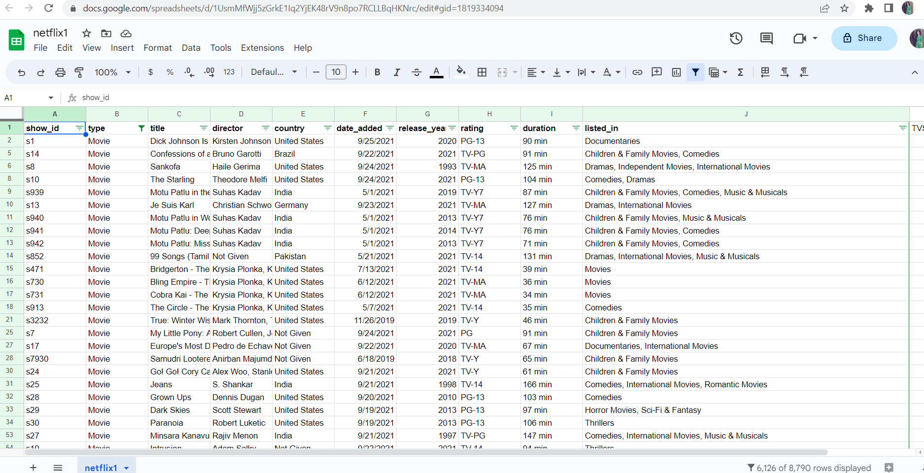
Dataset Columns

Slide 5
Dataset columns
show_id type
title
director
country
date_added
release_year
rating
duration
listed_in

Slide 6
Dataset link source
https://gist.githubusercontent.com/anith462/93e45b59df4acdc247a4de84874abf98/raw/01b51b7a39f0d483e92bc34cb628c5329dc30f70/gistfile1.txt
Dataset has tv shows names, director name, age groups, hours spent by the users,
years

Slide 7
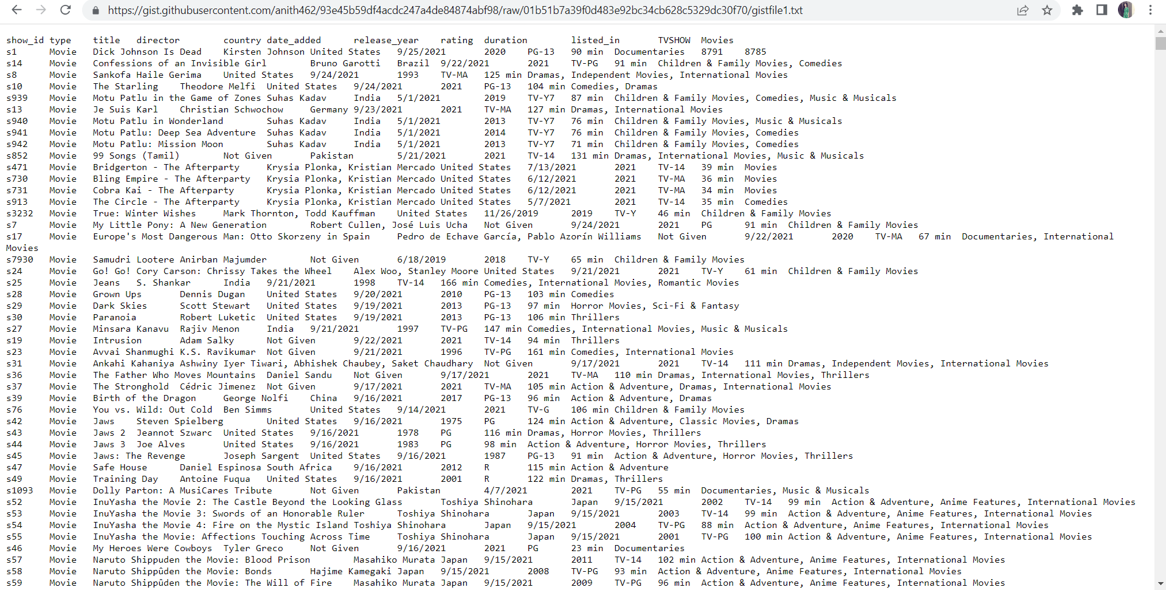
Dataset Image

Slide 8
Dataset Transformation
Since we require access to the data in order to show it in the vizhub, So I have created the raw github link for the dataset.

Slide 9
Implementation using tools
Cleaned the dataset and completed all the visualizations based on D3.js, Geometrics, Altair viewer, python code and vizhub also used html, javascript codes.
Github for storing the source code, Implementation, Python code, Vizhub links and Results Images.

Slide 10
Task Abstraction:
By using Python Code:
Questions 1- Questions 3
By using matplotlib of the Netflix Viewers in different countries by determining the number of viewers in each country by using python code
Number of Netflix Viewers by TV Shows and Movies
Yearly trend for Netflix.
By using Altair as the viewer visualizing the Netflix users information.
Question 11:
Netflix users data displaying based on the high amount of usage all around the world, country wide.

Slide 11
Task Abstraction: contd…
Using d3. Js Viz HUB:
Question 4- Question 10:
Question 4:
The number of the Netflix OTT platform users all around the world by using the pie chart.
VIZHUB Source:
https://vizhub.com/anith462/00420aa26d1f4fca99c9dc81691568d5?edit=files&file=index.html
Dataset URL:
https://gist.githubusercontent.com/anith462/1dd268fd8410696eed9eaad46b0d097e/raw/939e05b17385550ab362de6c8cf4b883740147e4/gistfile1.txt

Slide 12
Task Abstraction: contd…
Question 5:
Ratings of the Netflix viewers based on the types of shows like Romance, Horror, Documentary, drama, Animation, Action etc by using a type of Barchart.
VIZHUB source:
https://vizhub.com/anith462/928241283893443e953817198469e340?edit=files&file=index.html

Slide 13
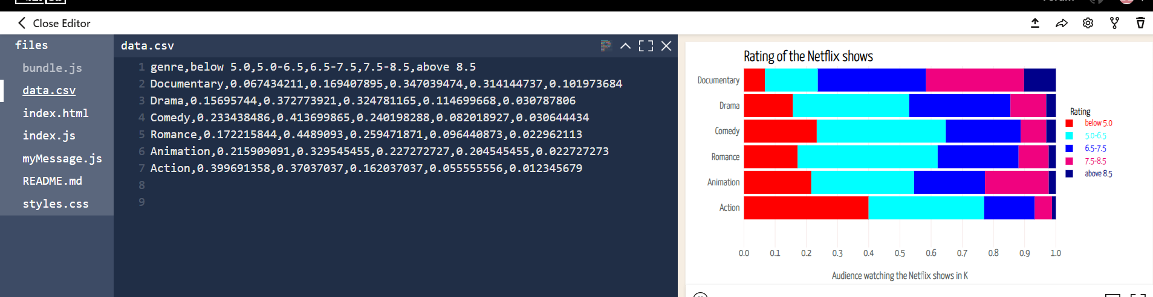
Task Abstraction: contd…
Question 5 Dataset:

Slide 14
Task Abstraction: contd…
Question 6:
Comparing the Shows watched by the audience Vs Avg Hours by using Bubble chart.
https://vizhub.com/anith462/311bc87fec2b46ffaa92e8a8c25e6489?edit=files&file=index.html
Question 7:
The distribution of the viewers based on the marital status.
https://gist.githubusercontent.com/anith462/47fb56e390a6e545283fb553768f8c71/raw/9ae6813787cdebe4642877be92eacce0e51d6e0d/gistfile1.txt
https://vizhub.com/anith462/9384f41f065d4d79805607e7914d7b9b?edit=files&file=index.html
Question 8:
Adding the dataset (data.csv) to the vizhub, adding a java script file, and subsequently generating java script code to display the average number of hours spent viewing episodes on Netflix by the top most popular nations.
https://vizhub.com/anith462/88504b16ede6421b84204f5b4212e4ef?edit=files&file=data.csv

Slide 15
Task Abstraction: contd…
Question 9:
By using Histogram in Vizhub displaying the hours spent by the teenagers.
https://vizhub.com/anith462/23867e6b78c0471f9ef8e6213d9287a2?edit=files&file=index.js
Question 10:
Displaying the top most country that uses the Netflix around the whole world by using geometrics and d3.js.
https://vizhub.com/anith462/6ccc9cfcf73d437c997f1409984abdff?edit=files&file=index.html

Slide 16
Task Abstraction
Data source attribution
Personas of the User and Use Cases
Preprocessing and Data Aggregation
Key performance indicators and pertinent metrics
Visualization Strategies
Response Time and Accessibility
Iterative Development

Slide 17
Task Results:
By using Python Code:
Questions 1- Questions 3
By using matplotlib of the Netflix Viewers in different countries by determining the number of viewers in each country by using python code
Number of Netflix Viewers by TV Shows and Movies
Yearly trend for Netflix.
By using Altair as the viewer visualizing the Netflix users information.
Question 11:
Netflix users data displaying based on the high amount of usage all around the world, country wide.

Slide 18
Task Results:
6:Comparing the Shows watched by the audience Vs Avg Hours by using Bubble chart.
7:The distribution of the viewers based on the marital status.
8:Adding the dataset (data.csv) to the vizhub, adding a javascript file, and subsequently generating javascript code to display the average number of hours spent viewing episodes on Netflix by the top most popular nations.
9:By using Histogram in Vizhub displaying the hours spent by the teenagers.
10:Displaying the top most country that uses the Netflix around the whole world by using geometrics and d3.js.
11:Netflix users data displaying based on the high amount of usage all around the world, country wide.

Slide 19
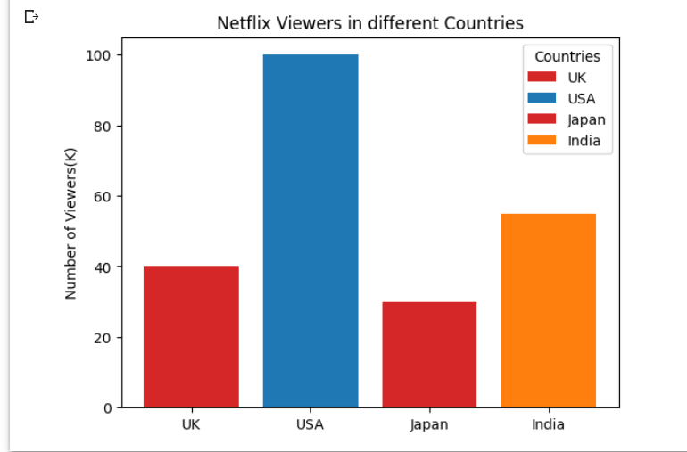
Task Results with Screenshots:

Slide 20
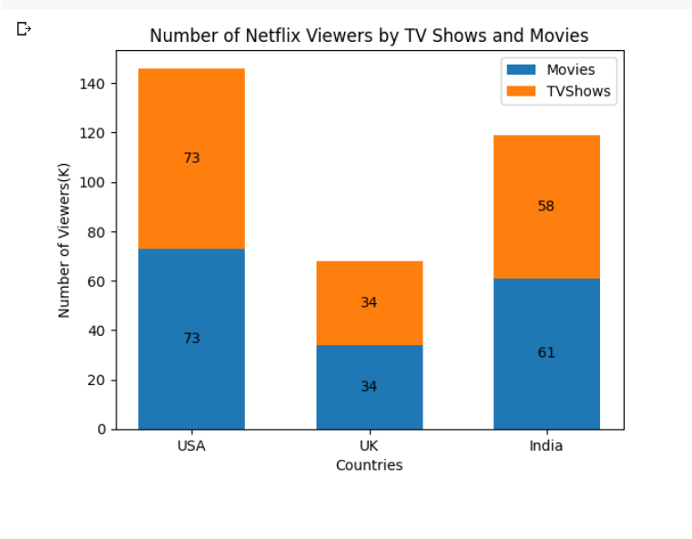
contd…

Slide 21
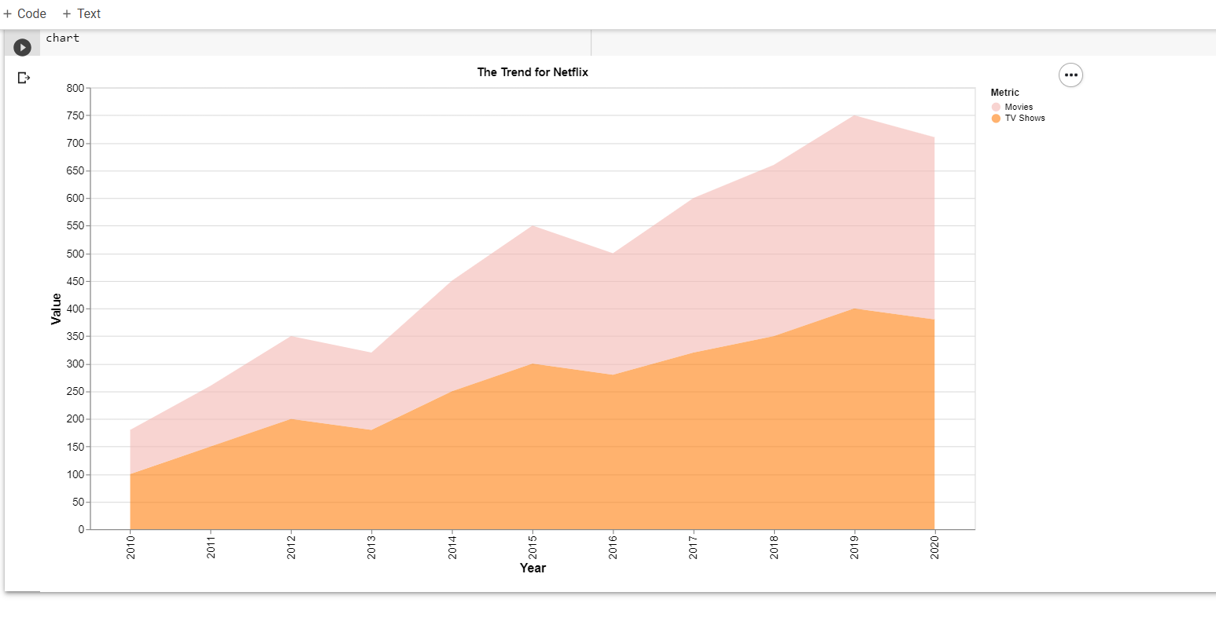
contd…
2.

Slide 22
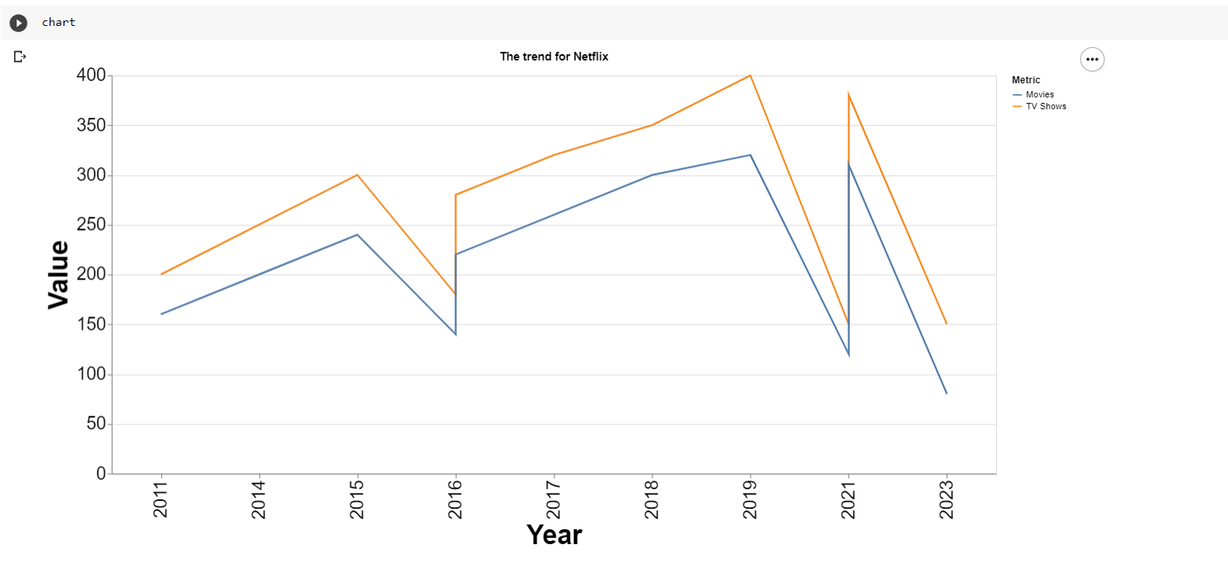
contd…
3.

Slide 23
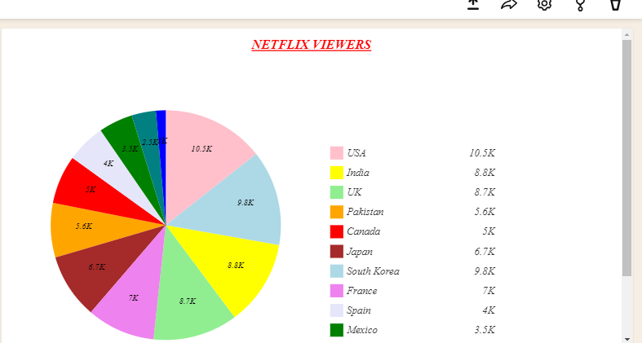
contd…
4.

Slide 24
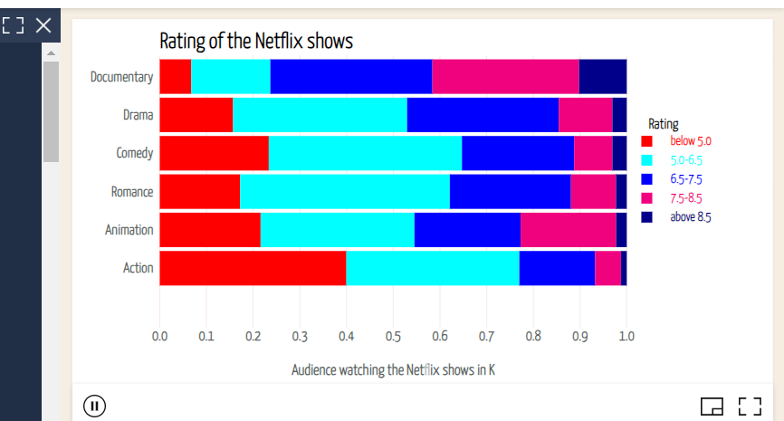
contd…
5.

Slide 25
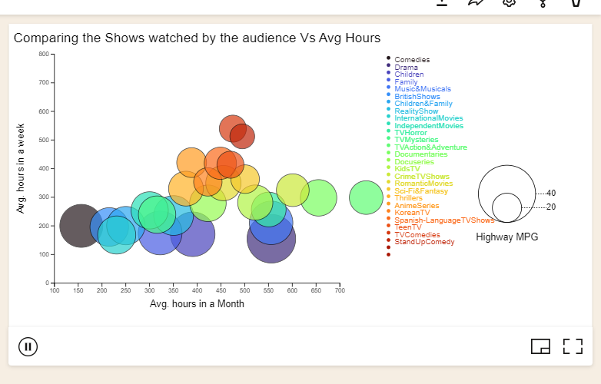
contd:
6.

Slide 26
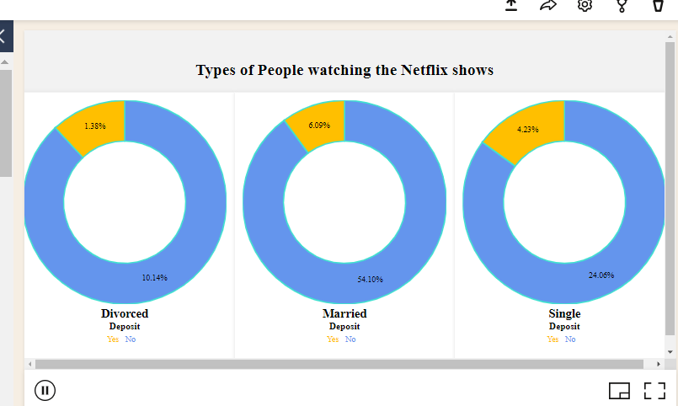
contd…
7.

Slide 27
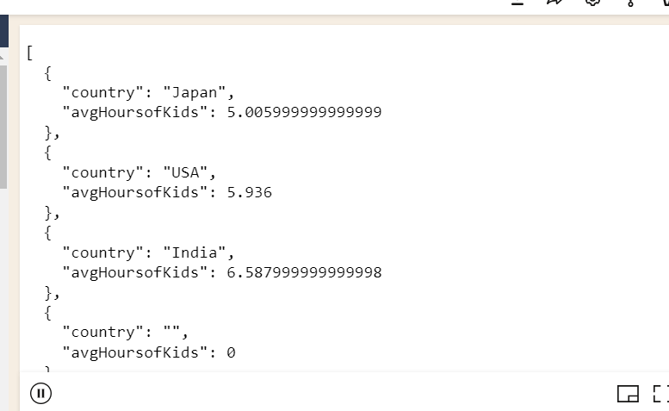
contd…
8.

Slide 28
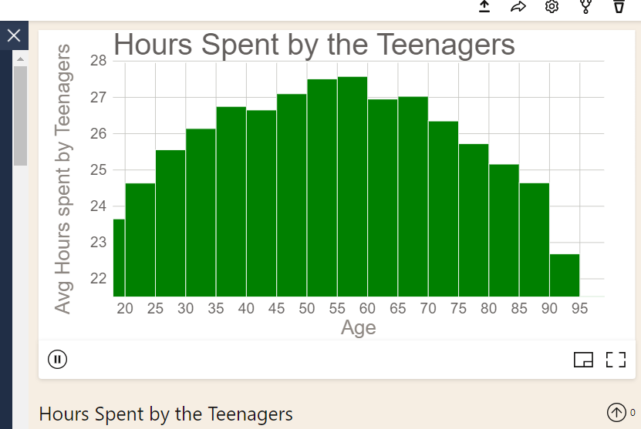
contd…
9.

Slide 29
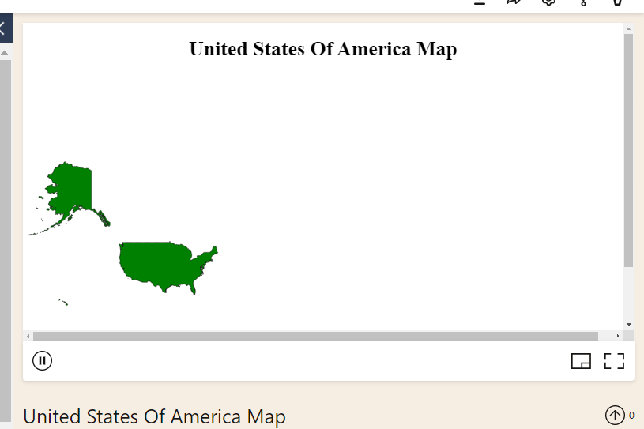
contd…
10.

Slide 30
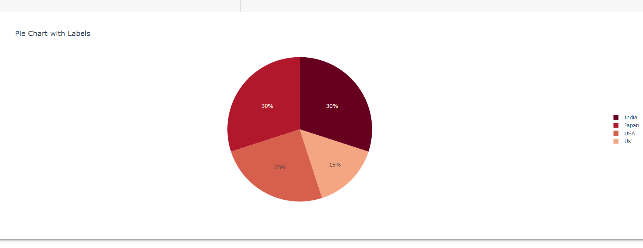
contd…
11.

Slide 31
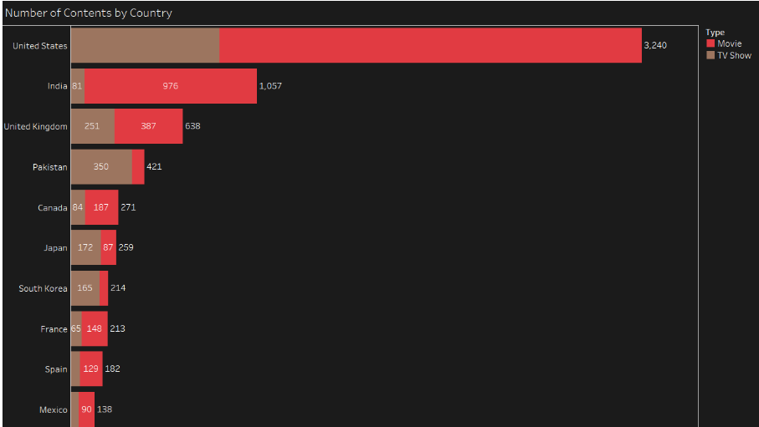
Dashboard

Slide 32
Dashboard
A filter for the years between 2008 and 2021 is available in the Tableau-hosted dashboard or sheet to determine the annual record.
To present a distinct alternative viewpoint. A bar graph of films and TV series is displayed.

Slide 33
Task distribution/Work Management:
I have worked in Group 17 by myself and cleaned the dataset and completed all the visualizations based on D3.js, Geometrics, Altair viewer, python code and vizhub also used html, javascript codes.
Provided all the screenshots with the results, dataset and code along with vizhub link.
I have worked on this project as 100 % owner.
Created all the visualizations
Web Page
Executed the code
Worked on Short Presentation
Done the video Recording

Slide 34
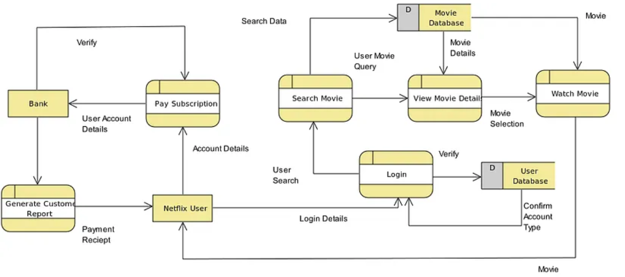
WorkFlow Diagram

Slide 35
WorkFlow Diagram Explanation:
The workflow diagram shows the steps involved in the Netflix app.
First the user has to login to the Netflix portal or an app.
So in order to login there should be an account by paying in online monthly or 3 months or yearly or can sign up.
Next step after successful login is to search for the TV shows or the movies by the viewers.
There are many sections involved in the Netflix OTT platforms those are TV shows, Movies, Kids shows, Stand up comedy, Drama, Action series, Documentary, Romance.

Slide 36
Github Source
https://github.com/anith462/DataVisualization_Presentation

Slide 37
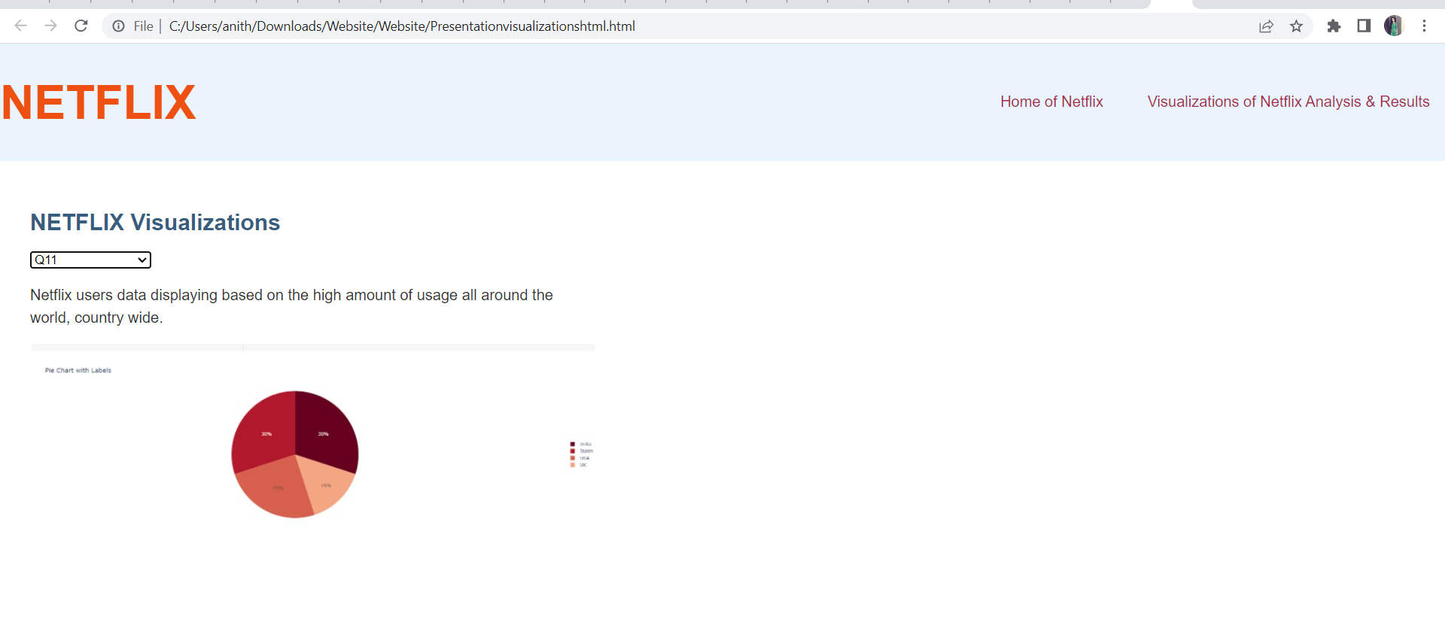
Website

Slide 38
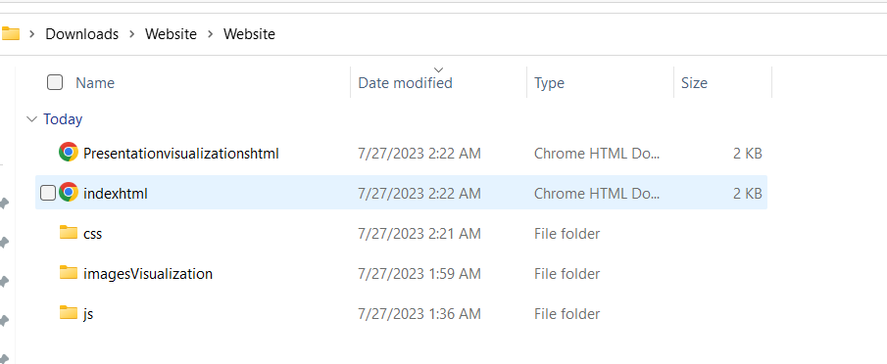
Website Files

Slide 39
Open Website
On click of the html file the website is open
Number of questions are asked
On selecting each question corresponding task and Image is displayed

Slide 40
Website Result

Slide 41
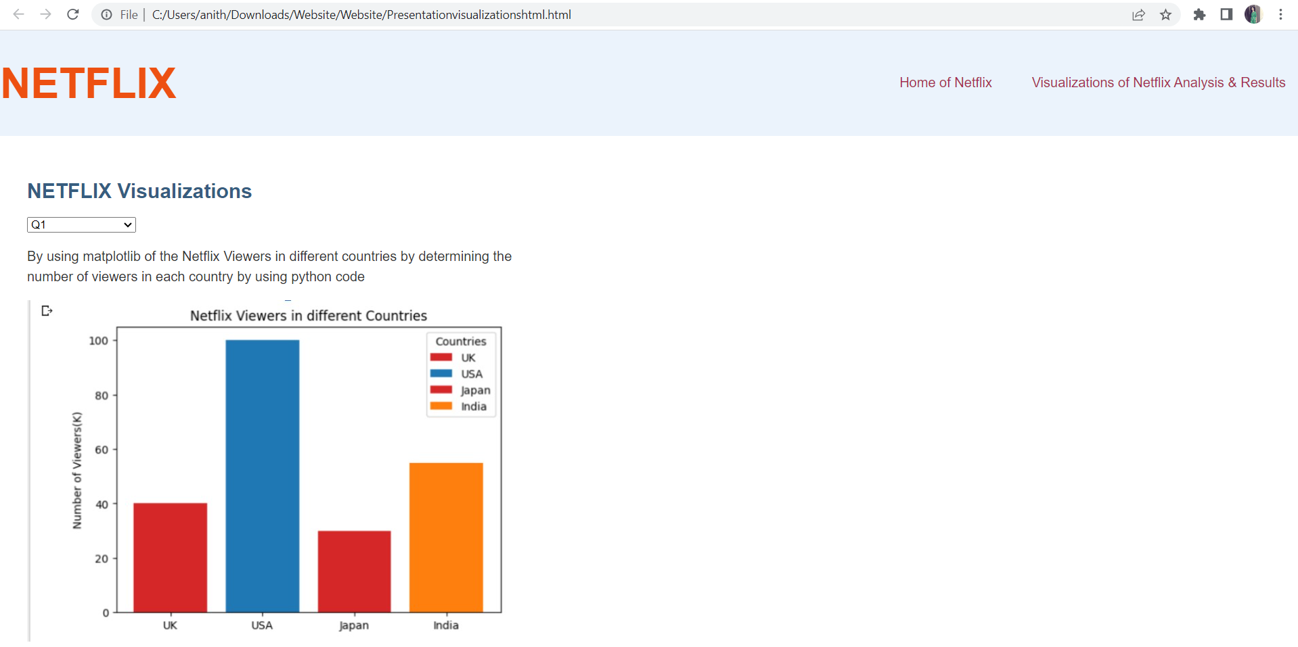
Website Result

Slide 42


